Slide 1

CSC 138 Presentation
Name | Matrix No
Muhammad Aqil Irfan Bin Badrul Hisham | 2017258974
Muhammad Hafiezudin Bin Rosdi | 2017224744
Muhammad Ramzi Amri Bin Rozmi | 2017231946

Slide 2
What are we going to present today ???
WE ARE GOING TO PRESENT A SYSTEM WHICH CALLED

Slide 3
FUNBUN SYSTEM
WHAT IS FUNBUN SYSTEM???

Slide 4
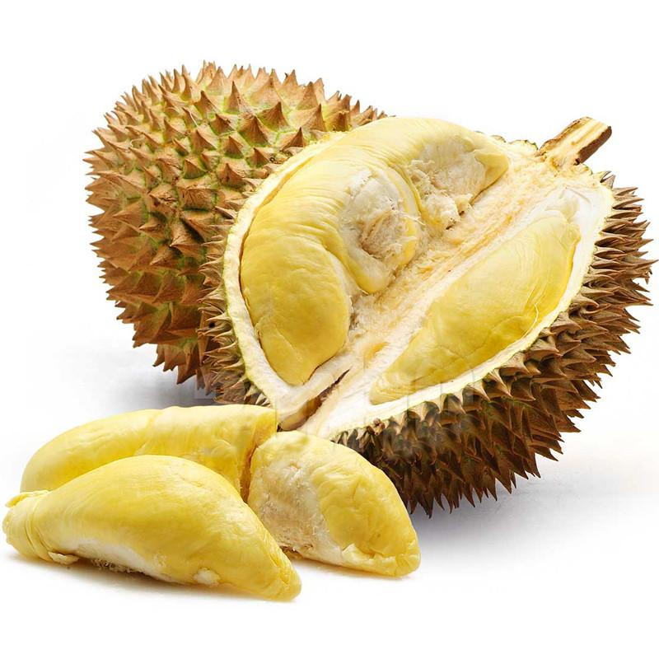
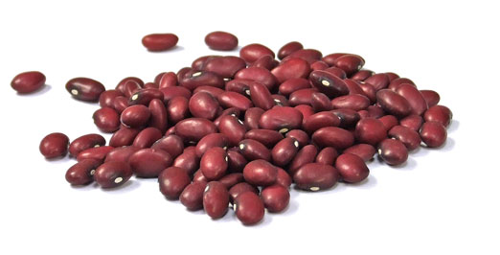
Funbun system is a system which selling buns that only consists two types of flavour which is :
and
DURIAN
RED BEAN

Slide 5
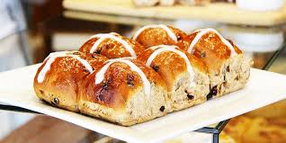
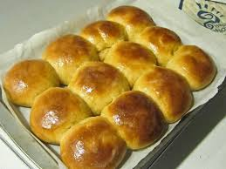
WE SELL THIS BUN IN TWO WAYS WHICH EITHER YOU WANT :
or
Half-Dozen
Dozen

Slide 6
EACH FLAVOUR WERE SELL IN DIFFERENT PRICE FOR EACH DOZEN OR HALF-DOZEN
FLAVOUR | DURIAN(RM) | RED BEAN(RM)
HALF-DOZEN | 6.00 | 5.00
DOZEN | 12.00 | 10.00

Slide 7


PAYMENT METHOD
WE PROVIDE TWO WAYS OF PAYMENT METHOD WHICH IS :
or
For those customers who live near Segamat, they can use the COD method because we only provide this service in Segamat area only which is the customers will meet up with us at One Segamat Shopping Mall which is addressed at 1 Shopping Complex, Second Floor, Jalan Kolam Air, Kampung Gubah,85000, Segamat, Johor
pay through bank in We will deliver the buns and as for the delivery, there are no delivery fees which means no additional fees that customers have to pay, they only have to pay for the buns only and the buns will deliver straight to your house

Slide 8
OBJECTIVE
WHAT IS OUR OBJECTIVE FOR THIS SYSTEM ???

Slide 9
1) To count the number of customers that order the bun for each type of bun.
2) To calculate the total average of the income in a month for each bun.
3) To calculate total income that has received after a customer uses our system in a month.

Slide 10
4) To calculate the highest order and identify the highest sales in a month.
5) To calculate the lowest order and identify the lowest sales.
6) To sort out from highest to lowest on how much quantity of bread has been sold per month by each type of buns.
7) To search the customer details and update by each type of buns.

